Slide 1

Network Statistics
A quick overview

Slide 2
Simple stuff
# Nodes, # Edges.
Connected Components: count of separate groups of nodes.
Graph Density: % of possible links that are present.

Slide 3
Degree distribution
E.g., run “Average Degree” tab in Gephi.
For pure random networks:
For preferential attachment:

Slide 4
Path length
E.g., run “Avg. Path Length” in Gephi.
The path length between nodes i and j defined as
Average path length
Network diameter

Slide 5
Centrality
Betweenness centrality: # of shortest paths across node
Degree centrality (node degree), also edge centrality (not in gephi)
Eigenvector centrality
Closeness

Slide 6
More Centrality
PageRank, like eigenvector centrality, can be written as an eigenvalue problem:

Slide 7

Clustering
Watts & Strogatz measure:
Newman (& Gephi):

Slide 8
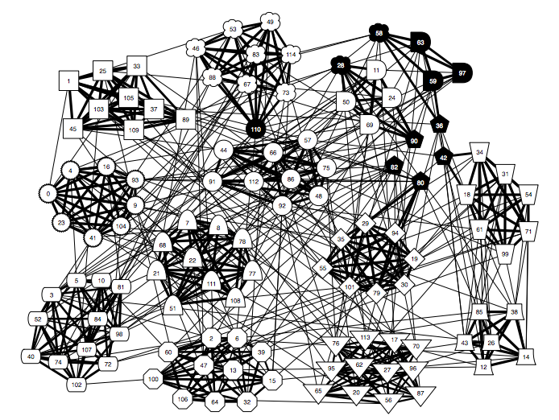
Modularity + Structure
From Clauset (2008)

Slide 9


